Slide 1

Laparoscopic gastric cancer surgery:
Is it time for Upper GI surgeons to follow in the footsteps of colo-rectal surgeons?
Shantanu Singh
M. Bainbridge
R. George
K. Akhtar
P. S. Senapati

Slide 2
BACKGROUND
first lap Colectomy- 1990
Multiple trials to prove safety.
A meta-analysis (n = 1536) from four RCTs.
NICE 2006
lap resection as an alternative to open surgery
2007
19 RCT
NICE 2000:
“Lap colectomy should only be a part of RCT
The National Training Programme
Training centres in 16 hospitals
first lap Gastrectomy 1991.
Azagra et al (first European) 1993
Most of the evidence from Asia
One in Europe (N= 30 lap) Huscher et al in 2005
One meta analysis
(4 RCTs 12 NRCT’s)
NICE 2008 : Evidence on the safety and efficacy of lap gastrectomy appears adequate to support .
Further publication on long term outcome & Survival
Two NRCTs
Four case series
Surgeons to submit data in database

Slide 3
BACKGROUND
2006 to 2010
Proportion of LCS nationally increased from 10.4% to 23%
Only 13% LG (most of these by hybrid approach - National O-G audit 2010)
25% (5,600) of patients would be suitable for LCS
Over 460 surgeons needed to support
221 trainees and trainers involved with the programme
Goal to train 250 consultants within 5 years

Slide 4
NICE : July 2008
LG slowly accepted in the West
Lower incidence (8,000 gastric Vs. 30,000 Colon yearly incidence in UK)
Main controversy
Level of lymph node dissection
Trained & Expert in advance techniques
Experienced mentor
Paucity of Long term outcome data
submit data to the central database for audit
The National O-G Cancer Audit 2010
Operating Surgeon
The yield of LN did not differ significantly

Slide 5
Background
Recent National audit did not show significant difference in LN harvest (concern raised by NICE).
Our snap shot of QOL favours the lap group
We have been performing this procedure since 2004 .

Slide 6
Aim
To compare the outcome of totally laparoscopic and conventional open gastric cancer surgery.
Primary outcome measure
  Lymph node harvest
  Resection margin clearance
  Morbidity & mortality
  Disease free survival
Secondary Outcome measure
  Operative time
  Conversion rate
  Blood loss & transfusion
  Post op analgesia
  ITU & Hospital Stay

Slide 7
Methods
A prospective database of all gastric cancer surgery with curative intention
Sept 2003 to Sept 2010
Performed by two surgeons
Population of 800,000
A total of 129 operations (72 Totally lap & 57 open).
Patients were followed up till 28th February 2011.
Median follow up Lap – 562 and Open- 695 days
SPSS was used for statistical analysis & Kaplan-Meier curve was used for survival analysis.

Slide 8
Operation
(67%)

Slide 9
Age Distribution

Slide 10
Gender
Notes:
Lap M:F 55:45 , 1.2:1
Open M:F 65:35, 1.9:1

Slide 11
Change of Practice

Slide 12
ASA

Slide 13
Pathological Staging (%)

Slide 14
ONCOLOGICAL SAFETY:

Slide 15
RESECTION MARGIN (%)
 | LAP | OPEN
R0 | 96% | 82.5%
R1 | 4% | 17.5%
T | 0.0194

Slide 16
LYMPH NODE HARVEST (Median)
P= 0.5197

Slide 17
LYMPH NODE HARVEST (MEDIAN)
P= 0.4632
Notes:
? remove

Slide 18
STAGED (MDIAN) LYMPH NODE HARVEST

Slide 19
PERI OPERATIVE ANALYISIS

Slide 20
Operative Time
Lap= 299.5 min. & Open = 286 min, (p= 0.0876)
Notes:
P value 0.0021
Are means signif. different? (P < 0.05) Yes
t=3.255 df=49
Mean ± SEM of column A 360.6 ± 23.75 N=15
Mean ± SEM of column B 290.4 ± 9.885 N=36
Difference between means 70.24 ± 21.58
95% confidence interval 26.83 to 113.6

Slide 21
Conversion (%)
SUB-TOTAL
TOTAL
 | SUBTOTAL | TOTAL
BLEEDING | 3 | 1
ADHESION | 3 | 1
BULKY NTUMOR | 3 | 0
INFILTRATION | 2 | 1
OTHER | 2 | 1
Notes:
AUDIT CONVERSION RATE 18%
Time line to evaluate
Aim is no compromise in safety

Slide 22
BLOOD LOSS (MEDIAN in ml.)
95% confidence interval = -589.9 to -172.2

Slide 23
BLOOD LOSS

Slide 24
BLOOD TRANSFUSION (UNIT)
 | LAP | OPEN
MEAN | 0.55 ± 0.16 | 0.76 ± 0.16
P Value | 0.431

Slide 25
POST OP. ANALGESIA

Slide 26
HDU / ITU STAY Median
P=0.9454
10 Patients in lap group did not need HDU/ ITU admission at all.
All patients of open group were admitted in HDU/ ITU.

Slide 27
HOSPITAL STAY (MEDIAN)
P=0.2207
Social stay in hospital also included
No significant difference in subgroup
Notes:
Plot curve

Slide 28
COMPLICATIONS
 | LAP SUB (n=56) | OPEN SUB (n=19) | LAP TOTAL (n=16) | OPEN TOTAL (n=38)
COMPLICATION | 14 (25%) | 3 (19%) | 7 (44%) | 14 (50%)
NO COMPLICATION | 42 (75%) | 13 (81%) | 9 (56%) | 14 (50%)
LEAK | 1 | 0 | 0 | 2
CHEST | 3 | 1 | 3 | 2
WOUND, PORT INF | 5 | 1 | 2 | 7
OTHER | 5 | 1 | 2 | 3

Slide 29
IN HOSPITAL MORTALITY
Notes:
P value????

Slide 30
IN HOSPITAL MORTALITY
LAP SUB (n= 56) | OPEN SUB (n= 19) | LAP TOT (n=16) | OPEN TOT (n=38) | LAP (n=72) | OPEN (n=57)
3 (5.3%) | 0 | 1 (6.3%) | 2 (5.3%) | 4 (5.5%) | 2 (3.7%)
Notes:
AUDIT: IN HOSPITAL MORTALITY 6.0%
MIS= 3.2%
They represent a snapshot of performance at a time when the minimally invasive approach is being slowly introduced LEARNING CURVE

Slide 31
SURVIVAL

Slide 32
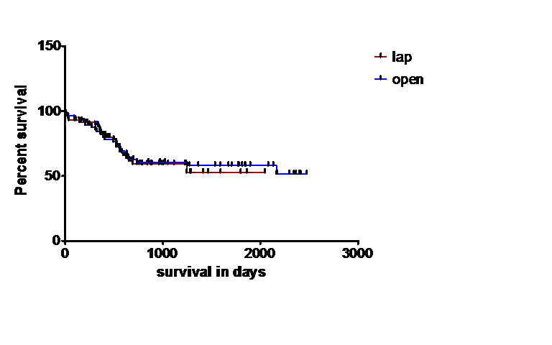
DISEASE FREE SURVIVAL
LAP VS OPEN
Stage wise survival curve comparison - No significant difference
P value 0.8472
95% CI of ratio 0.5912 to 1.897
Median Survival undefined

Slide 33
Actual Disease Free Survival

Slide 34
SUMMARY & CONCLUSION
SIGNIFICANT DIFFERANCE
  Blood loss
  Operating time in total gastrectomy
TREND
  More R0 resection
  PCA use in Lap group
  Less HDU/ITU utilization
NO DIFFERANCE
  LN Harvest
  Post op complication
  In hospital mortality
  Short & medium term disease free survival

Slide 35
CONCLUSION
Above results reveal the oncological adequacy of laparoscopic gastric cancer surgery is comparable with conventional open surgery.

Slide 36
  These results need to be revalidated by Multicentre RCT
      Long term survival
      Quality of life
At present many centres in UK are performing laparoscopic gastrectomy & can be part of the trial.
While awaiting results ( a time consuming process) competent surgeons & centres can provide structured training programme & mentorship, as done by our Colo-rectal colleague.

Slide 37
THANK YOU

