Slide 1
Mechanism of Diabetes remission after Bariatric Surgery
Mr Siba Senapati
Consultant Upper GI and Bariatric Surgeon
Salford Royal Hospital
DORN 2012
University of Manchester

Slide 2
Background
In mid-twentieth century relationship between improvements in diabetes and gastric resection surgery began to be published
Friedman et al. The amelioration of diabetes mellitus following subtotal gastrectomy. Surg Gynecol Obstet 1955
Forgacs et al. Improvement of glucose tolerance in diabetes following gastrectomy. Z Gastroenterol 1973
Kellum et al. Gastrointestinal hormone responses to meals before and after gastric bypass and vertical banded gastroplasty. Ann Surg 1990

Slide 4
Types of obesity Surgery
Restrictive
  Vertical banded gastroplasty
  Adjustable Gastric Banding
  Sleeve Gastrectomy
Malabsorptive
  Jejunoileal bypass
  Biliopancratic Diversion
  Duodenal Switch
Combined
  Gastric Bypass
Newer Novel models
  Sleeved jejunoileal bypass
  Ileal interposition
  Endobarrier
  Miscellaneous

Slide 5
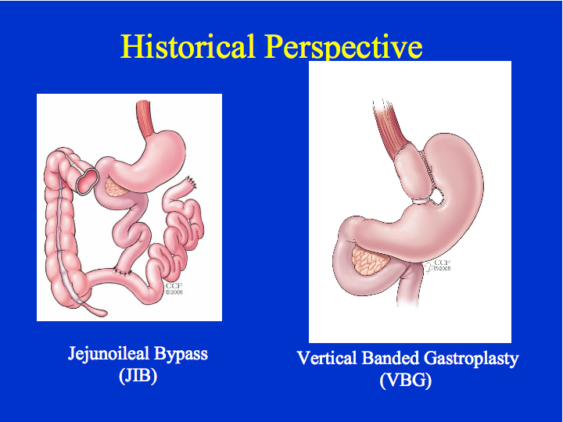

Slide 6
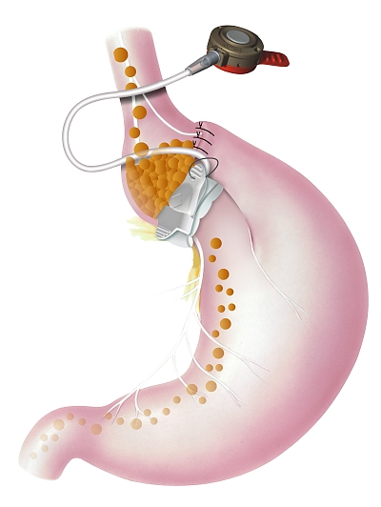
ADJUSTABLE GASTRIC BANDING

Slide 7


Slide 8
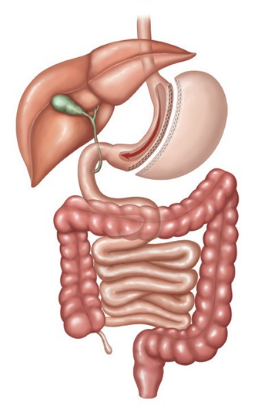
Sleeve Gastrectomy

Slide 9
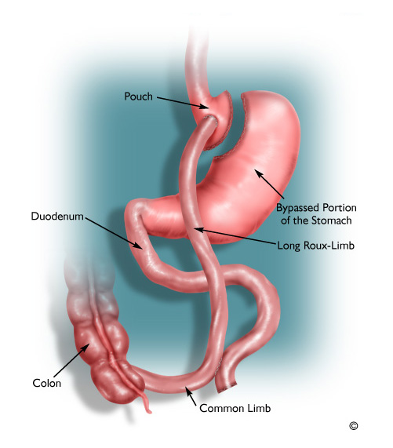
Gastric Bypass

Slide 10


Slide 11
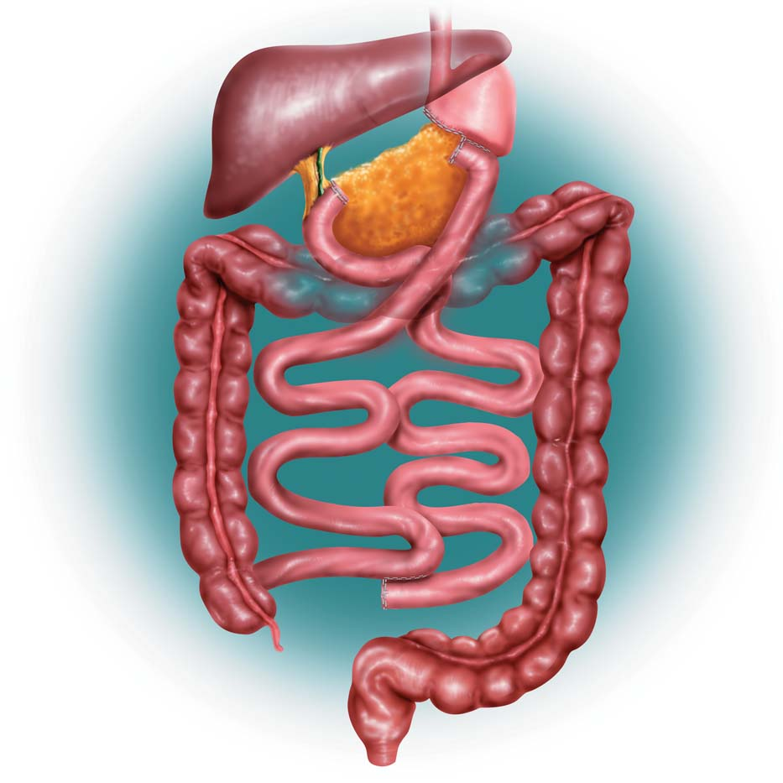
BILIOPANCREATIC DIVERSION (BPD)
Malabsorptive
larger stomach pouch
higher amount of weight loss
greater malabsorption of nutrients
excess weight loss of 74 % at 1 year, 78 % at 2 years, 81 % at 3 years, 84 % at 4 years, and 91 % at 5 years*.
resolves type 2 diabetes in almost 77% of patients**
*Duodenal Switch: An Effective Therapy for Morbid Obesity – Intermediate Results” Baltasar A, Bou R. Obesity Surgery 2001 Feb; 11(1): 54-8.
**Buchwald H, Avidor Y, Braunwald E, et al. Bariatric Surgery—A Systematic Review of the Literature and Meta-analysis. Journal of the American Medical Association 2004 Oct 13;292(14).

Slide 12
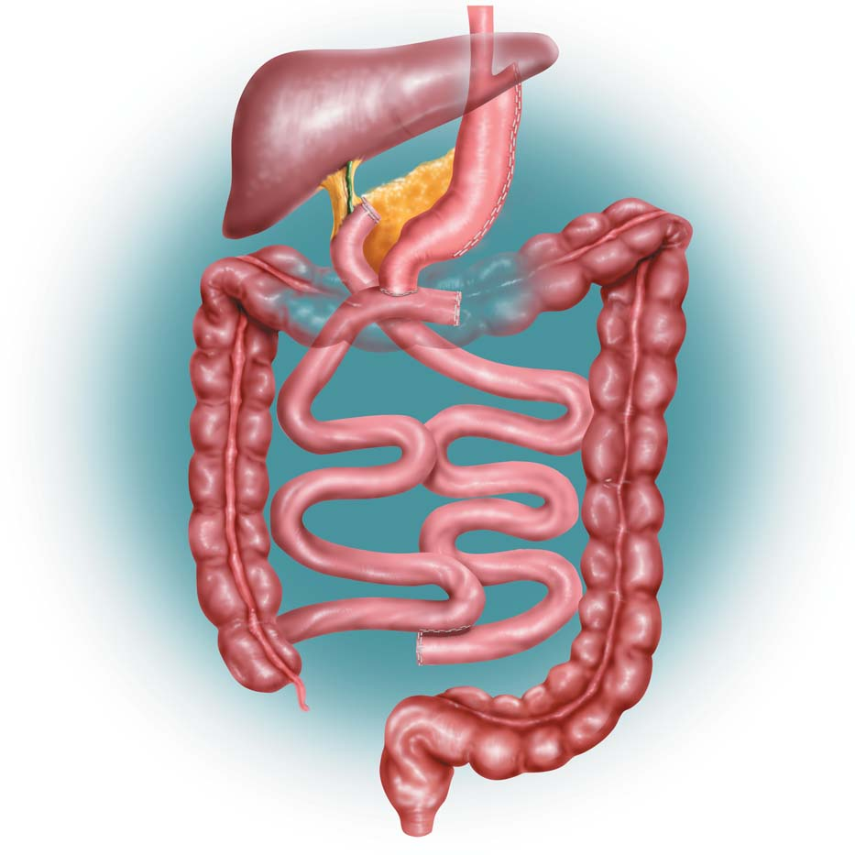
BILIOPANCREATIC DIVERSION (BPD) WITH DUODENAL SWITCH
Malabsorptive
larger stomach pouch
higher amount of weight loss
greater malabsorption of nutrients
excess weight loss of 74 % at 1 year, 78 % at 2 years, 81 % at 3 years, 84 % at 4 years, and 91 % at 5 years*.
resolves type 2 diabetes in almost 77% of patients**
*Duodenal Switch: An Effective Therapy for Morbid Obesity – Intermediate Results” Baltasar A, Bou R. Obesity Surgery 2001 Feb; 11(1): 54-8.
**Buchwald H, Avidor Y, Braunwald E, et al. Bariatric Surgery—A Systematic Review of the Literature and Meta-analysis. Journal of the American Medical Association 2004 Oct 13;292(14).

Slide 16
Co-morbidity Resolution
 | Gastric Banding | Gastric Bypass | BPD or DS
EWL | 47% | 62% | 70%
Resolution of DM | 48% | 84% | 99%
Resolution of Hyperlipidaemia | 59% | 68% | 83%
Resolution of HT | 43% | 68% | 83%
Resolution of Sleep Apnoea | 95% | 80% | 92%
Buchwald et al. JAMA.2004:292:1724-1737

Slide 17
Bariatric surgery versus conventional medical therapy for type 2 diabetes
60 patients between ages 30-60years
BMI 35 or more
At least 5years of diabetes
HBA1c 7% or more
Randomised to medical therapy or gastric bypass or BPD
End point diabetes remission at 2yrs (fbs 5.6mmol and HBA1c of <6.5% in absence of pharmacotherapy
No remission in pts tted with medication whereas 75% in GBYP and 95% in BPD
In severely obese pts with type 2 diabetes bariatric surgery resulted in better control than did medical therapy
      Mingrove G et al. N Eng J Med April 2012

Slide 18
Bariatric Surgery versus intensive medical therapy in obese patients with diabetes
150 patients between ages of 20-60
BMI range of 27-43
Average HBA1c 9.2%
Duration of diabetes >8years
Randomised to intensive medical tt versus GBYP or Sleeve gastrectomy
Primary end point was HBA1c of 6% at 12months
Proportion of pts achieved primary end point was 12% in medial arm and 42% and 37% in the GBYP and Sleeve gastrectomy respectively
Bariatric surgery achieved glycaemic control in significanty more pts than medical therapy alone
Schauer P R et al. N Eng J Med April 2012

Slide 38
Obesity surgery is cost effective.
> Economic payoff of obesity surgery within 3.5 years as a
result of reductions in direct healthcare costs.
> After 5 years, the total hospitalization costs for control group was 29 % higher than for those who had surgery.
Five-Year Healthcare Utilization
 | BARIATRIC MEAN (SD) | CONTROLS MEAN (SD) | P-VALUE
Hospitalizations | 2.75 (3.44) | 3.17 (3.22) | 0.001
Hospital Days | 21.05 (38.97) | 36.59 (25.41) | 0.001
Physician Visits | 9.62 (15.8) | 17.00 (21.74) | 0.001
Christou NV, Sampalis JS, Liberman M, et al. Surgery Decreases Long-Term Mortality, Morbidity, and Health Care Use in Morbidly Obese Patients. Annals of Surgery 2004;240(3):416-424.

Slide 39
The clinical effectiveness and cost-effectiveness of bariatric (weight loss) surgery for obesity: a systematic review and economic evaluation.
Southampton Health and Technology Assessment Centre
Surgery is Safe and Cost-effective for Moderate and Severe Obesity
      Picot J et al, Health Technol Assess 2009sept13(41)1-190,215-357

Slide 40



Safety of Ambulatory Bariatric Surgery
Senapati PS, Menon A, Al-Rashedy M, Thawdar P, Akhtar K, Ammori BJ
Department of Obesity and Metabolic Surgery
Salford Royal Hospital, UK
Presented at IFSO, Barcelona May 2012

Slide 41
Results
Operation type | Number of patients | Median Age (Years) | Median Body mass index (BMI) (kg/m²) | Median Length of stay (hours) | Median 30 Day Readmission (%)
All cases | 585 | 46 | 52.8 | 30 | 2.6
 |  | (18-67) | (37.8-80.9) | (13-552)
RYGB | 471 | 46 | 52.8 | 32 | 3.0
 |  | (20-67) | (44.2-80.9) | (17-552)
LSG | 53 | 48 | 52.3 | 23 | 1.9
 |  | (18-63) | (37.8-72.0) | (19-72)
LAGB | 27 | 45 | 46.2 | 29 | 0
 |  | (26-64) | (31.2-63.6) | (13-264)
Revisional | 34 | 43 | 58.4 | 26 | 0
 |  | (26-61) | (22.5-71.0) | (16-552)

Slide 42
Success vs. Failure of 23 hour stay
 | Postoperative Stay <23 hour | Postoperative Stay >23 hour | P value
Median Age | 43 years | 46 years | <0.001
% Females | 80% | 76.10% | 0.23
BMI | 50 kg/m² | 50.8 kg/m² | 0.61
% Diabetics | 18% | 36% | <0.001
Operating Time | 85 minutes | 95 minutes | 0.18
30 day Readmission | 2.90% | 2.40% | 0.72
Mortality | 0% | 0.2% (1 mortality)
Complications | 1.8% | 3.4% | 0.29

Slide 43

Thank you for listening

Slide 44
